Slide 1

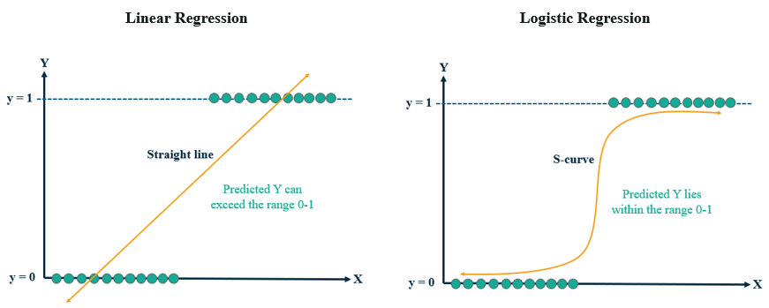
Linear vs. Logistics Regression
Sigmoid function
we use sigmoid to map predictions to probabilities in the range (0,1)
Logistic regression is a machine learning algorithm that can be used to classify input data into discrete output (e.g., input emails into spam or non-spam and tumour images into benign or malignant)

Slide 2
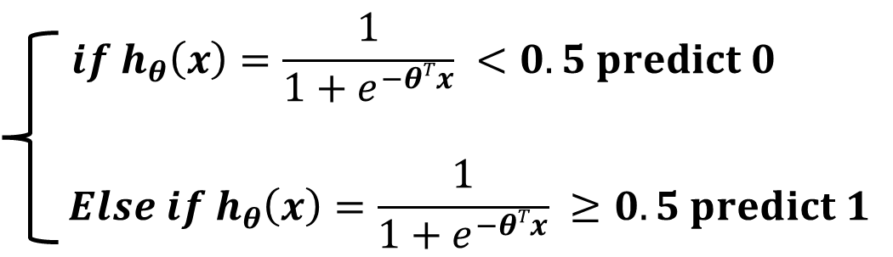
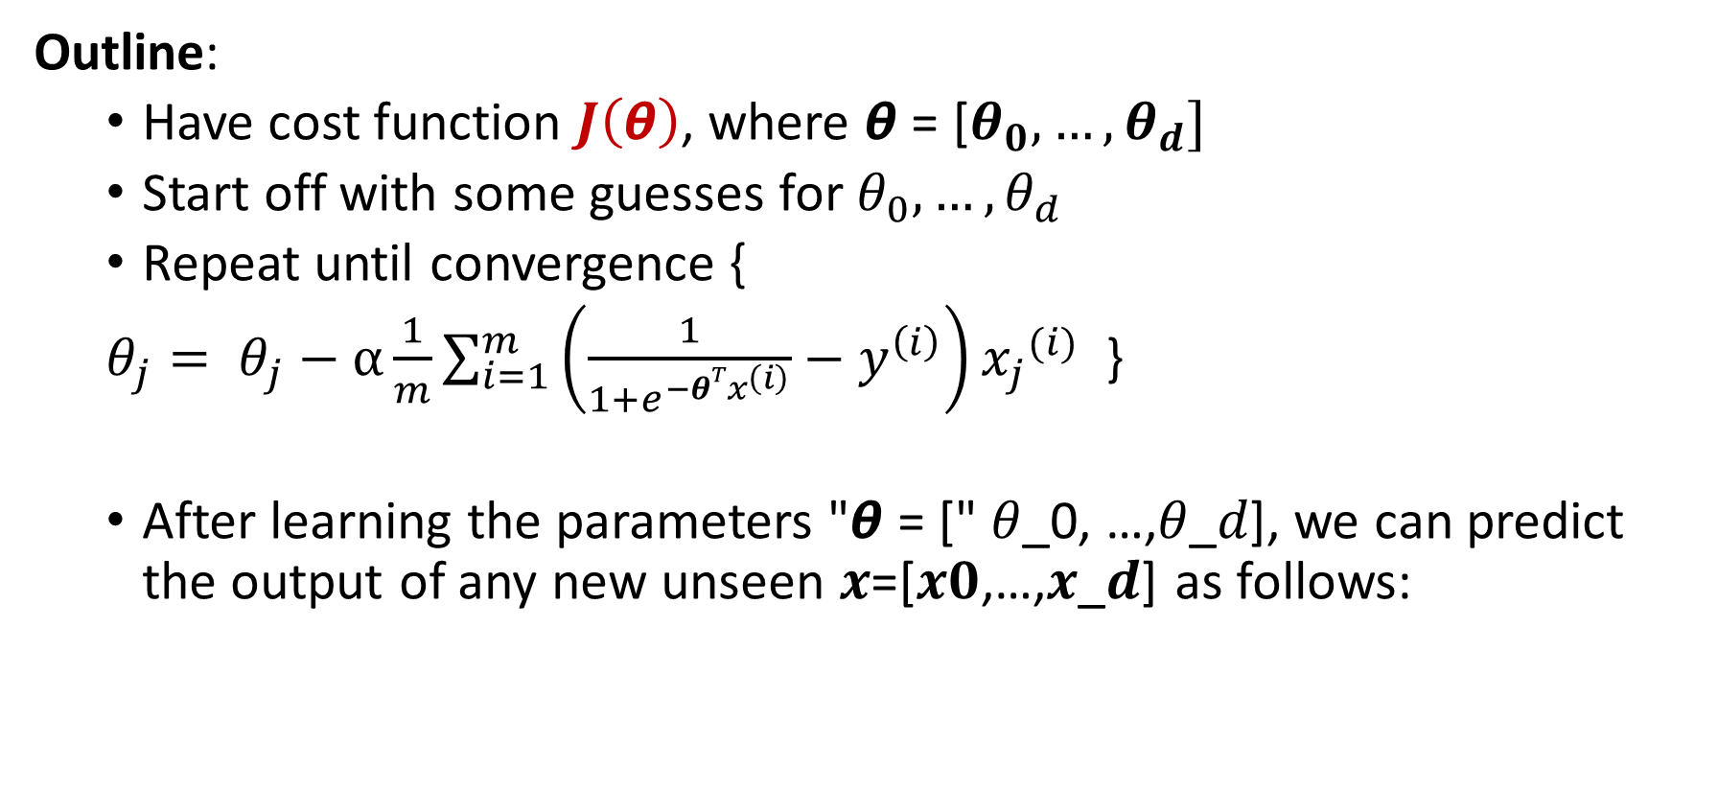
Gradient Descent For Logistic Regression
Outline:
Have cost function $J\left(\text{θ}\right)$, where $\text{θ}\text{ = [}θ_{0}, …,θ_{d}]$
Start off with some guesses for $θ_{0}, …, θ_{d}$
Repeat until convergence {
$θ_{j}= θ_{j}−α\frac{1}{m}\sum_{i=1}^{m}{\left(\frac{1}{1+e^{−θTx^{\left(i\right)}}}−y^{\left(i\right)}\right)}{x_{j}}^{(i)}$ }
After learning the parameters "𝞱 = [" 𝜃_0, …,𝜃_𝑑], we can predict the output of any new unseen 𝒙=[𝒙𝟎,…,𝒙_𝒅] as follows:

Slide 3
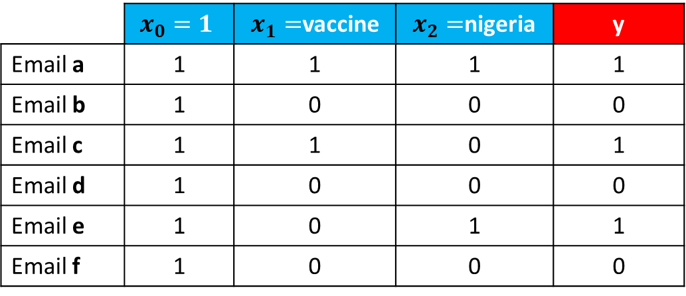



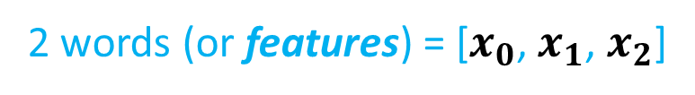
Training Phase
Let us apply logistic regression on the spam email recognition problem, assuming 𝞪 = 0.5 and starting with $θ$ = [0, 0, 0]
2 words (or features) = [${x_{0}\text{,} x}_{1}$, $x_{2}$]
 | $$x_{0}=1$$ | $x_{1}=$vaccine | $x_{2}=$nigeria | y
Email a | 1 | 1 | 1 | 1
Email b | 1 | 0 | 0 | 0
Email c | 1 | 1 | 0 | 1
Email d | 1 | 0 | 0 | 0
Email e | 1 | 0 | 1 | 1
Email f | 1 | 0 | 0 | 0
We define 3 parameters (the first one, i.e., $θ_{0}$, is the intercept)
1 entails that a word (i.e., “vaccine”) is present in an email (i.e., “Email a”)
Testing Phase
Based on the training, check whether the following email (feature vector) is spam or not spam?
$x_{1}=\text{vaccine}$ = 1 | $x_{2}=N\text{igeria}$ = 1

Slide 4
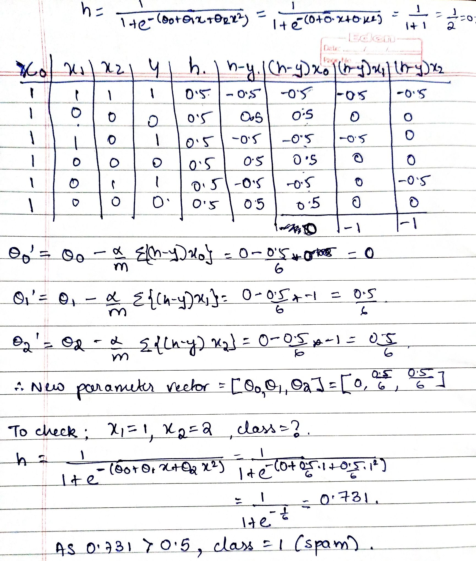


Training Phase
Testing Phase

Slide 5
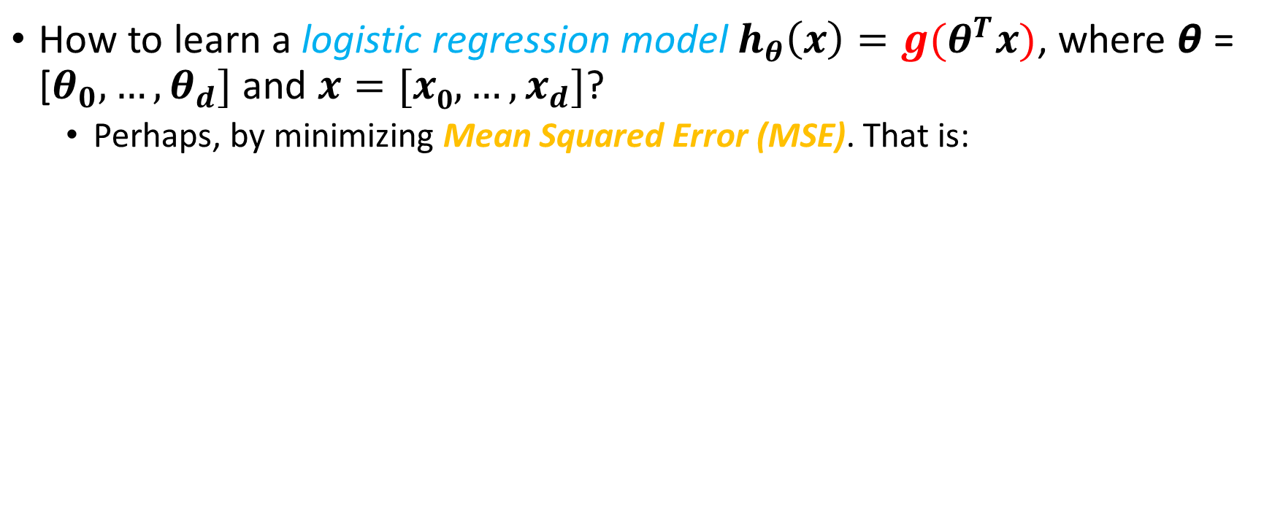
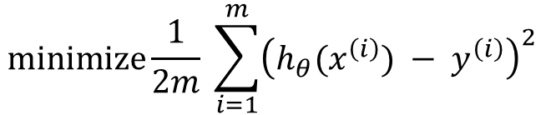
Exercise -1
Suppose you are given the following training examples
Build a Logistic regression classifier. Assume 𝞪 = 0.1 and starting with $θ$ = [0, 0, 0]
Report all the parameters of the model after 1 epoch.
After 1 epoch $θ$ = [0.017, 0.07, 0.084]
Classify the new example $x^{(4)}={[1,2]}^{T}$
${h_{θ}^{}(x}^{(4)})=$0.5633 >0.5 → so predicted class label = 1
$$x^{(1)}={[3,3]}^{T}$$ $$x^{(2)}={[1,0]}^{T}$$ $$x^{(3)}={[4,2]}^{T}$$ | $$y^{(1)}=1$$ $$y^{(2)}=−1$$ $$y^{(3)}=1$$

Slide 6
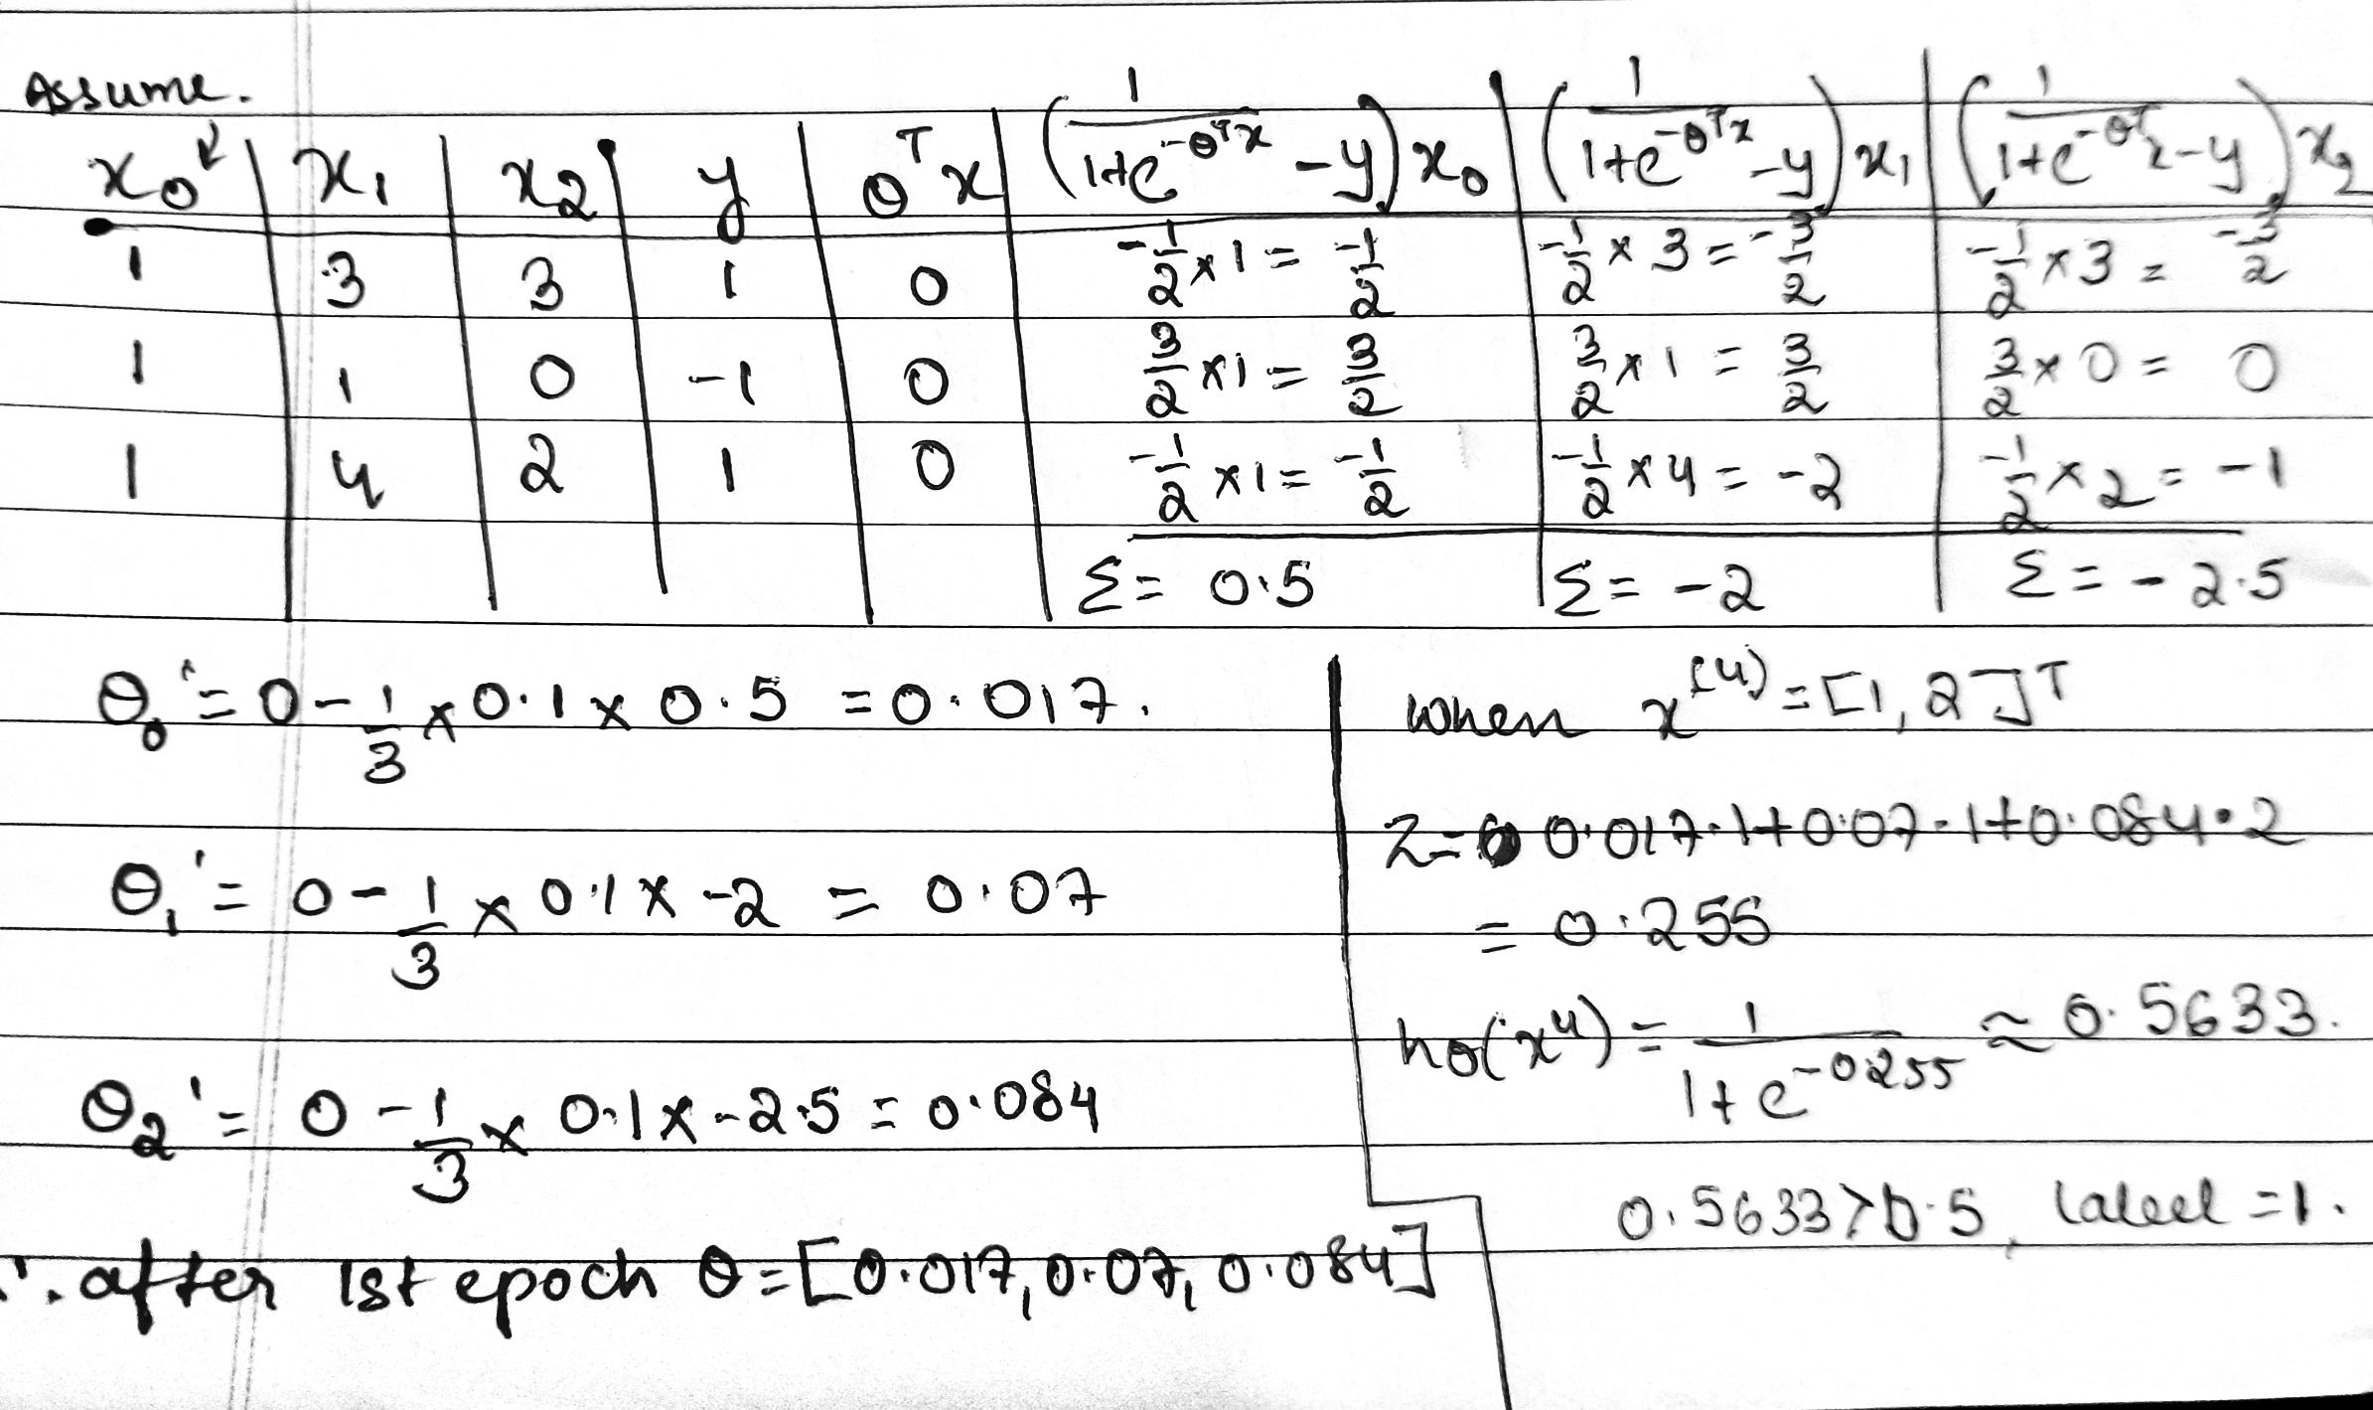

Slide 7

Exercise-2
Classify whether weight = 55kg as obese (1) or not(0) using Logistic Regression model with the training dataset given below assuming 𝞪 = 0.5 and starting with $θ$ = [0, 0,0]
Age | Weight | y
12 | 56 | 1
45 | 65 | 0
30 | 79 | 1
23 | 98 | 1
17 | 45 | 0
32 | 58 | 0
33 | 81 | 1
34 | 50 | 0
21 | 49 | 0
Age:[12,45,30,23,17,32,33,34,21]
Weight:[56,65,79,98,45,58,81,50,49]
Y=[1,0,1,1,0,0,1,0,0]

Slide 8
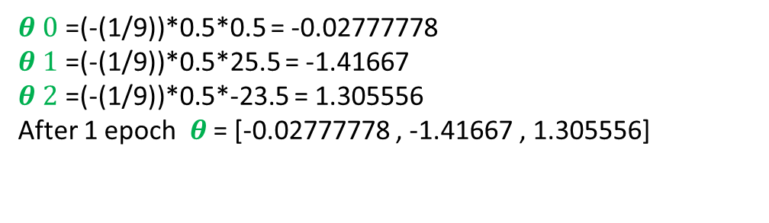
x0 | x1 (age) | x2 (weight) | y | (1/(1+e^(-θTx) )-y)x_0 | (1/(1+e^(-θTx) )-y)x_1 | (1/(1+e^(-θTx) )-y)x_2
1 | 12 | 56 | 1 | -0.5 | -6 | -28
1 | 45 | 65 | 0 | 0.5 | 22.5 | 32.5
1 | 30 | 79 | 1 | -0.5 | -15 | -39.5
1 | 23 | 98 | 1 | -0.5 | -11.5 | -49
1 | 17 | 45 | 0 | 0.5 | 8.5 | 22.5
1 | 32 | 58 | 0 | 0.5 | 16 | 29
1 | 33 | 81 | 1 | -0.5 | -16.5 | -40.5
1 | 34 | 50 | 0 | 0.5 | 17 | 25
1 | 21 | 49 | 0 | 0.5 | 10.5 | 24.5
 |  |  | sum -> | 0.5 | 25.5 | -23.5
$θ 0$ =(-(1/9))*0.5*0.5 = -0.02777778
$θ 1$ =(-(1/9))*0.5*25.5 = -1.41667
$θ 2$ =(-(1/9))*0.5*-23.5 = 1.305556
After 1 epoch $θ$ = [-0.02777778 , -1.41667 , 1.305556]
Question is incomplete as it gives us 55 as weight but no value for age…

Slide 9
Logistic regression
Advantages:
Makes no assumptions about distributions of classes in feature space
Easily extended to multiple classes (multinomial regression)
Quick to train
Very fast at classifying unknown records
Good accuracy for many simple data sets
Disadvantages:
Linear decision boundary

